Slide 1


Building Damage Assessment
This presentation focuses on the innovative methods and technologies utilized for assessing building damage through local drone imagery. It highlights the significant advantages of drones in enabling rapid data collection and analysis, which ultimately enhances disaster response and recovery efforts. By leveraging drone technology, we can ensure a more efficient and effective approach to assessing structural integrity in the aftermath of disasters.

Slide 2

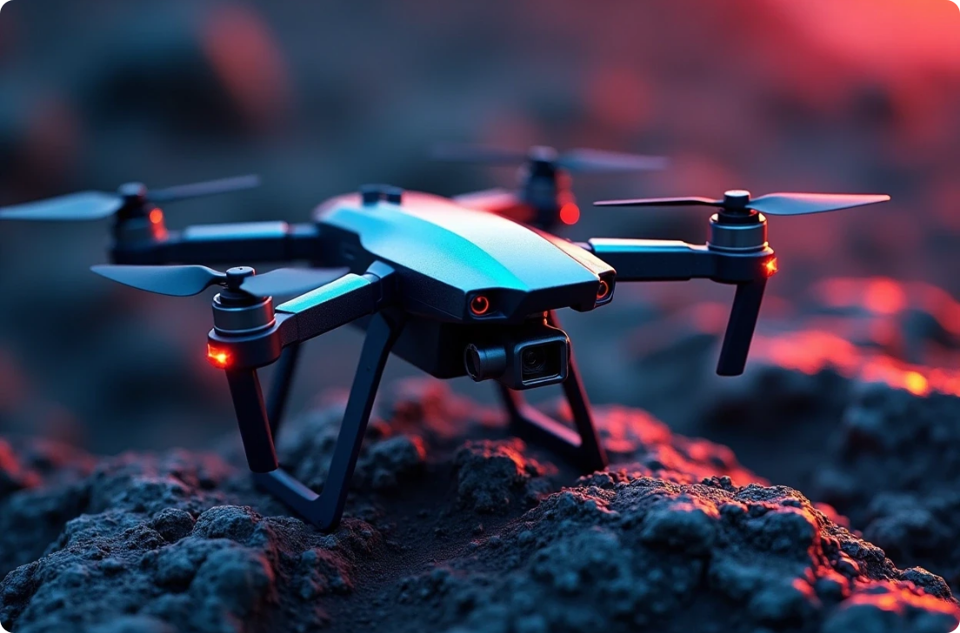

Introduction to Drone Imagery
Definition and Purpose
Advantages of Drones
Applications
Drone imagery refers to aerial photographs captured by unmanned aerial vehicles (UAVs). This technology enables a bird's-eye view of buildings, making it essential for damage assessment post-disasters.
Drones can access hard-to-reach areas, gather high-resolution imagery quickly, and reduce the risks to human life during assessments, especially in hazardous environments.
Apart from damage assessment, drones are used in mapping, urban planning, and environmental monitoring, showcasing their versatility in various fields.

Slide 3



Damage Assessment Techniques
Thermal Imaging
2
Equipped with thermal cameras, drones can detect heat anomalies, indicating issues like water leaks or electrical failures.
Visual Inspection
Using high-resolution images, inspectors can identify structural damages such as cracks or collapsed areas.
1
LiDAR Technology
LiDAR allows for precise 3D modeling of buildings, helping to quantify the extent of damage.
3

Slide 4




Data Analysis and Processing
1
Image Processing Software
Advanced software algorithms analyze drone-captured imagery, extracting valuable data about structural integrity and identifying patterns indicative of damage.
2
Machine Learning Applications
AI algorithms can be trained to automatically identify damages in images, enhancing the speed and accuracy of assessments compared to traditional methods.
3
Creating Damage Reports
Processed data can be compiled into detailed reports, providing stakeholders with the information needed for insurance claims, repairs, or further action.

Slide 5






Case Studies on Drone Applications
1
2
3
Natural Disasters
Urban Development Projects
Insurance Assessments
Drone imagery aids in rapid damage assessment post-hurricanes or earthquakes.
Insurers use drone data for quicker and more accurate property damage evaluations.
Drones monitor construction sites for safety compliance and structural issues.

Slide 6





Challenges and Limitations of Drone Operations
2
Weather Dependence
Adverse weather conditions like high winds or rain can impede aerial surveys and affect the quality of the imagery captured.
Regulatory Issues
Drone operations are subject to regulations that can vary by location, potentially limiting their use for certain assessments or requiring permits and certifications.
1
Technological Limitations
While drones are powerful tools, equipment costs, maintenance, and the need for skilled operators can pose challenges to widespread adoption.
3

Slide 7






Future Trends in Drone Technology
1
Integration with AI
Enhancing real-time damage assessment capabilities.
2
Enhanced Imaging Technologies
Improving data quality for accurate damage assessments.
3
Wider Adoption
More organizations adopting drone imagery across industries.

Slide 8



Utilizing Drones for Building Damage Assessment
Significance of Drone Usage
Call to Action
Future Potential
Utilizing drones for building damage assessment offers numerous benefits including speed, safety, and accuracy.
Stakeholders in disaster management, urban planning, and insurance should consider integrating drone technology.
Ongoing advancements in drone technology promise greater applicability and efficiency in building damage assessments.

